Slide 1
The GLA Primary Health & Learning Centre
Creating a self-reliant model of reliable and affordable primary healthcare and education for rural India
GLA PH & LC is a project of the Paanchajanya Public Charitable Trust (Regd.)

Slide 2
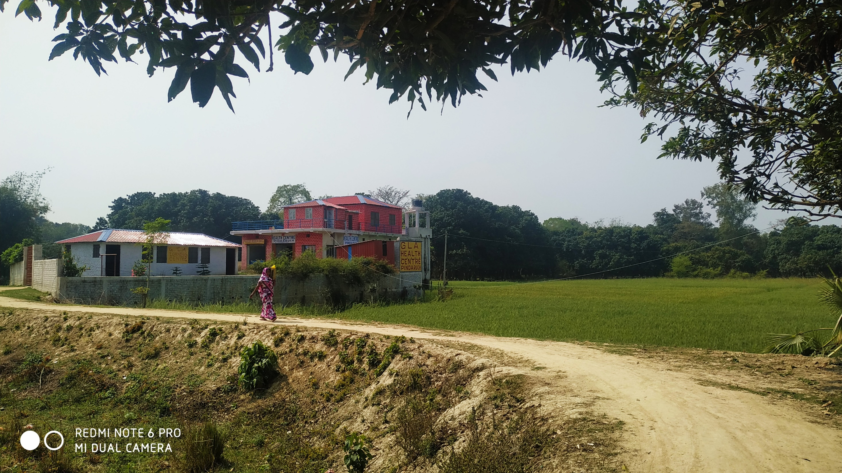

Slide 3
Healthcare-related Efforts

Slide 4
The GLA PH & LC, Pindaruch: Key Highlights
20 km from Darbhanga Medical College Hospital
160 km from Patna Airport
Surrounded by 14 Villages, Total Population: 1,40,000 approximately
Who Need Primary Health Care: 70% Dalit, Women, Illiterate, Anemic
Common Problems: Fever, Indigestion, Gynecology- and Age Related
Email: glahealthcentrepindaruch8077@gmail.com
Phone: (0091) 73208-22725, 93862-65468, 86517-93577, 73510-03081

Slide 5
Work Done Since Inauguration (2018)
No. of Patients Treated | 1,500 Approximately
Test & Training Camps Organized | Nine
Cost of Building | ₹ 46,00,000 Approximately
Income from Fees & Rent | ₹ 60,000
Honorariums & Recurring Expenses | ₹ 18,00,000
Donations Received | ₹ 41,00,000
Loans | ₹ 9,00,000
Doctors Who Ran Camps
Dr. Ganesh Choudhary, Dr. Chhaya Jha, Prof. KN Jha, Dr. M Kishore, Dr. KK Gautam, Dr. MK Sinha, Dr. Ragini Jha, Dr. Reeta Jha, Dr. Shankaranand Jha)

Slide 6
The GLA PH & LC: Key Accomplishments
Medical Officer | Dr. Ganesh Choudhary, BA MS(K0L), MD. (Emergency Medicine/PUNE). Available for 30 hours/week
Dispensary | A Licensed Pharmacy Selling Drugs at Under Approved Rates
Diagnostics | Available Tests: Pathology, ECG, BP, and Blood Sugar (fasting & Post Prandial)
Paramedics | Two
Important Rooms | Two Doctor’s Rooms Two Observation rooms One Doctor’s Residence: 1
Lay Secretary | One

Slide 7
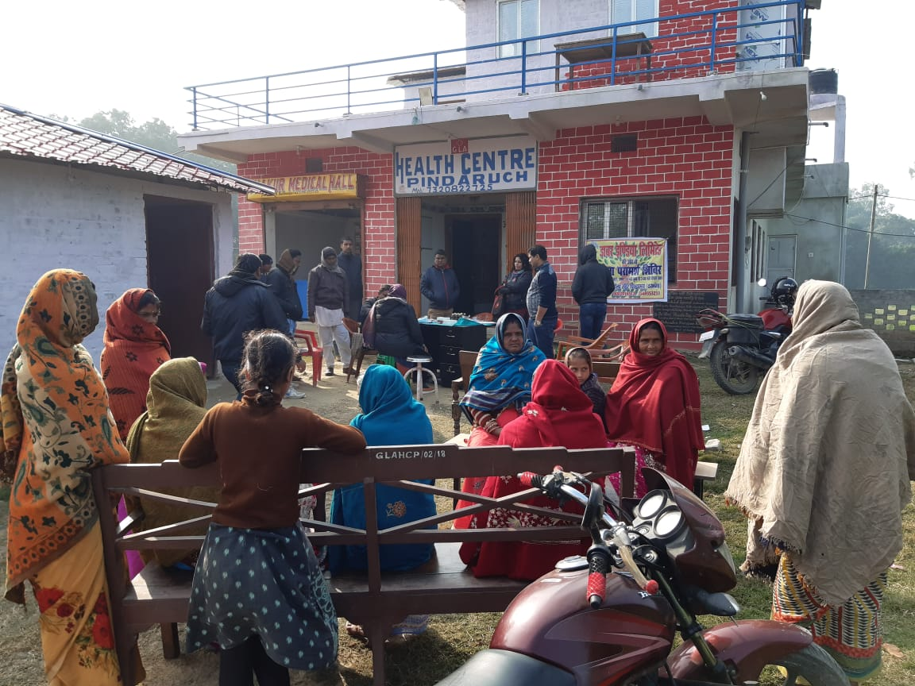
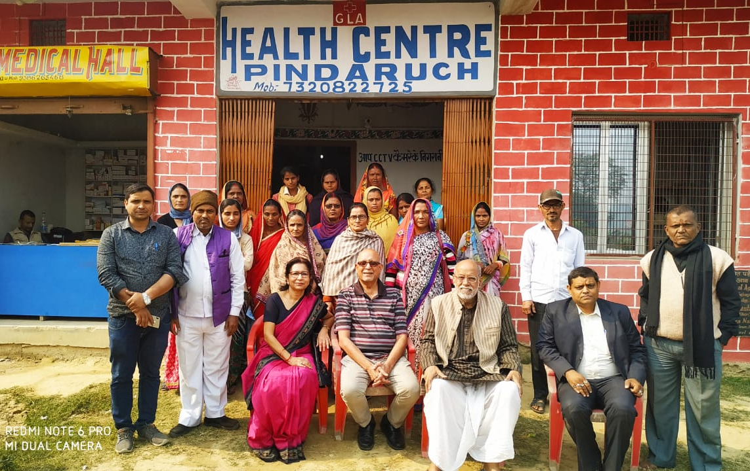
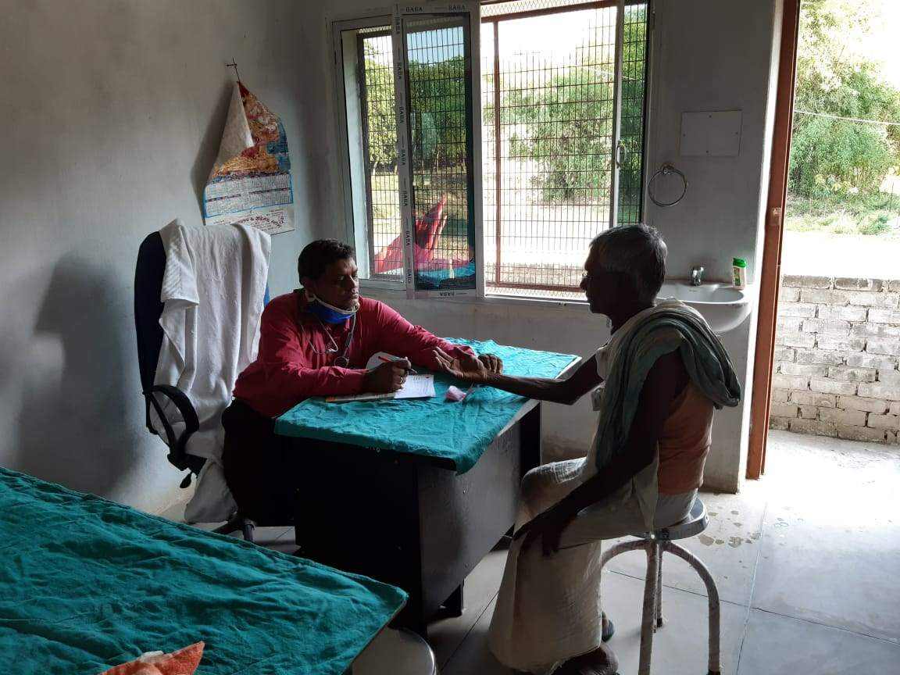
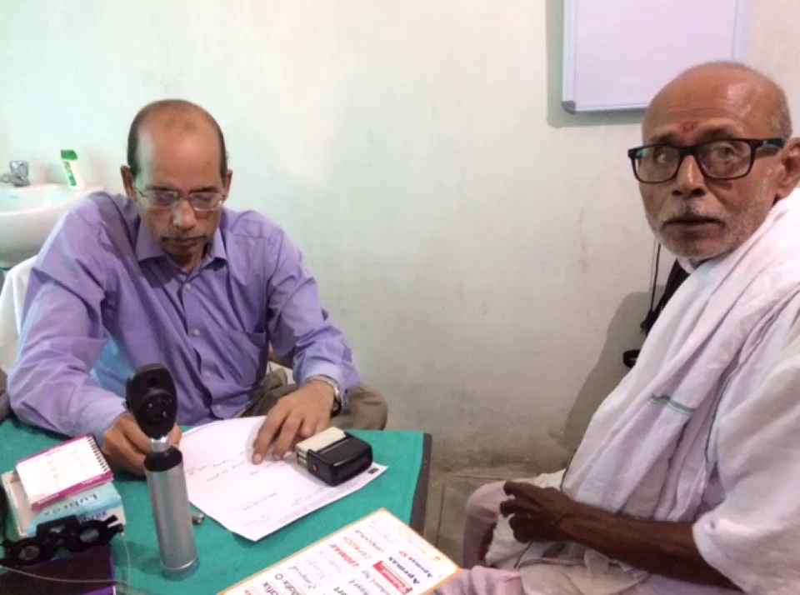
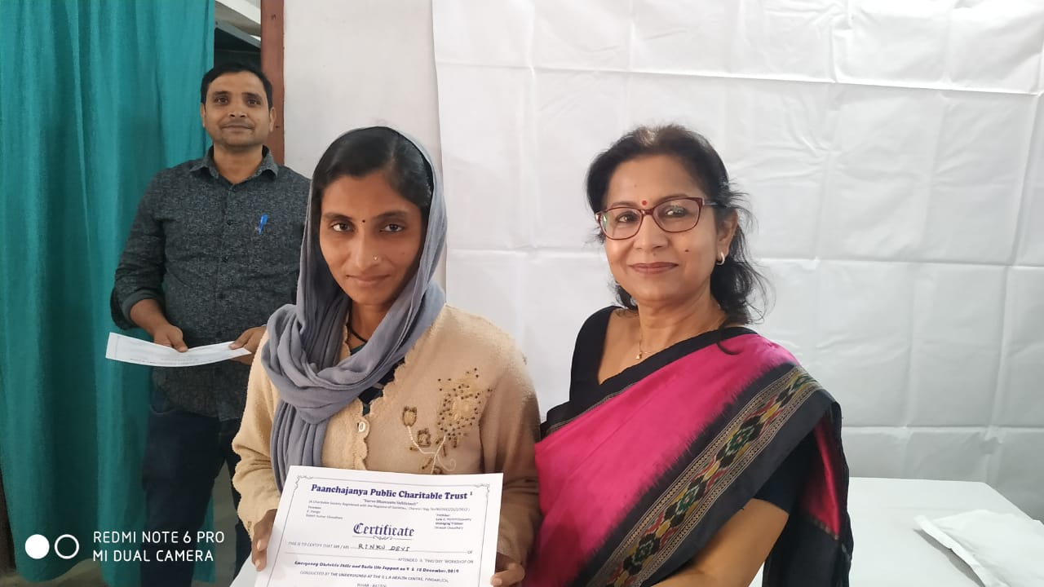
A Few Photos

Slide 8
Micro-view: Meeting a Doctor in Darbhanga
Visiting a proper clinic is so intimidating and costly that rural folk literally try everything before they go to see a doctor. This includes trying home remedies, local compounders, and so on.
When they do visit a clinic, these are the approximate costs, making a revisit very tough:
Transport | ₹ 500
Doctor’s Fee | ₹ 500
Pathology | ₹ 1,000
Radiology | ₹ 500
Prescribed Drugs | ₹ 1,000
Daily Wage Loss for Patient & Attendant | ₹ 1,000
Total Minimum Cost | ₹ 4,500

Slide 9
Macro-view: North Bihar & Rural South Nepal
North Bihar Population | Nearly 8 Crore (7,60,00,000)
Population of Madhes (Nepal) | Nearly 3 Crore (2,70,00,000)
No. of PH & LCs Needed | At 1 PH & LC for 1,00,000 People, 1,100 PH & LCs needed
No. of People that Can Visit a PH & LC Daily | 100
Potential Earnings | 100 Patients x ₹ 200 x 300 Days = ₹ 60,00,000 p.a.
Approximate Expenses | 1 Doctor: ₹ 50 Lakhs, 4 Paramedics: ₹ 6 Lakhs, Maintenance: ₹ 4 lakh
Patient Benefits per Visit | ₹ 3,000 + Time + Harassment + Maltreatment

Slide 10
Learning-related Efforts

Slide 11
The GLA LC, Pindaruch: Our Story
Work in Pindaruch began in 2012, with the founding of the Paanchajanya Public Charitable Trust. We then worked with government schools in the area, supporting them with materials and ideas as required.
In 2016, we received funding from IIT Madras, which enabled us to hire and train our own teachers, who then taught in five government schools in Pindaruch.
In 2019, with the GLA PHC infrastructure in place, we started our own learning center.

Slide 12
The GLA LC, Pindaruch: Key Goals
To help enhance reading proficiency in English and the local languages, and improve general awareness.
To educate and empower local villagers to take over the task of emancipation through education.
To educate and empower local villagers to take over the running and administration of the primary health & learning center.

Slide 13
About Our Students
More than 50% came from educationally and economically backward casts and classes
20% came from culturally backward classes
About 8% came from other economically backward classes.
Nearly all our students came from families where parents are daily wage earners and, by and large, illiterate.
No child had seen a book or had facilities to study at home. Things like study table, light and a corner for themselves were unknown to them

Slide 14
Work Done So Far
Worked with more than 600 children between the ages of 8-15 so far, of which more than 350 were girls.
Recruited and trained more than 20 local citizens, who joined us as volunteer teachers.
Offered mid-day meals to children and emphasized a culture of respect for students and teachers.
Supplied schools with story and drawing books, painting kits, furniture for children and teachers, etc.
Focused on traditional education and learning through storytelling, songs, music, and cultural programmes.

Slide 15
GLA LC: Key Facilities
Rooms for children to sit and learn
Furniture and old computers received from the Manigachhi Branch of the State Bank of India in August, 2019
A small children’s library
More than 15 trained local volunteer teachers
More than 150 children, who attend classes in batches after their regular classes at their respective schools.

Slide 16
GLA LC Today
This year has been tough for us, as for the rest of the world, thanks to the Corona epidemic.
Apart from the COVID crisis, we’ve had severe floods hitting the region. Therefore, the health center has been closed since March this year.
But we hope to resume work once the pandemic dies out.
Finally, we feel that each village must itself address its needs in education and health care.
We are moving in that direction, but any help is welcome!

Slide 17
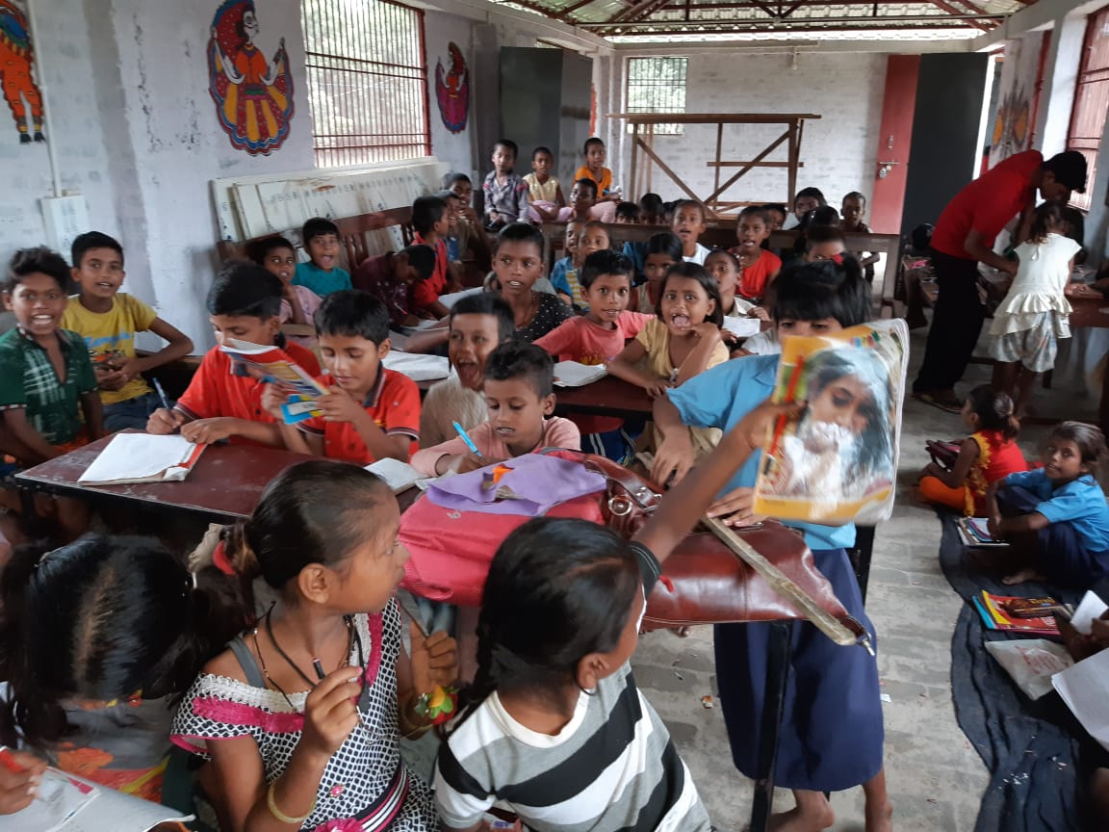
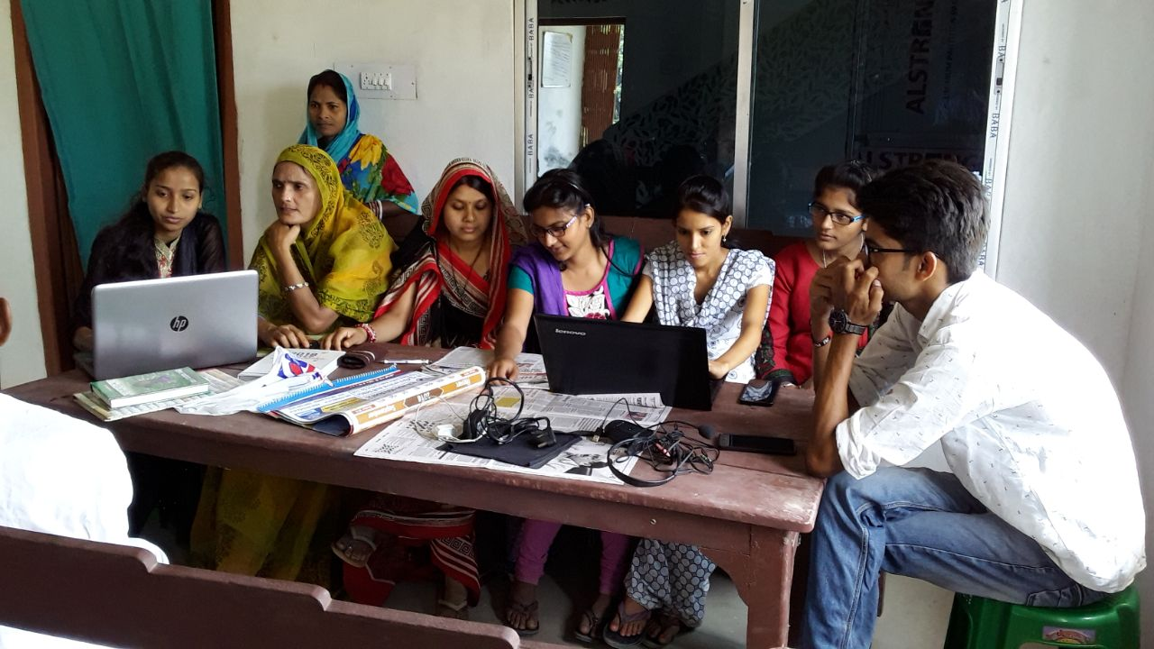
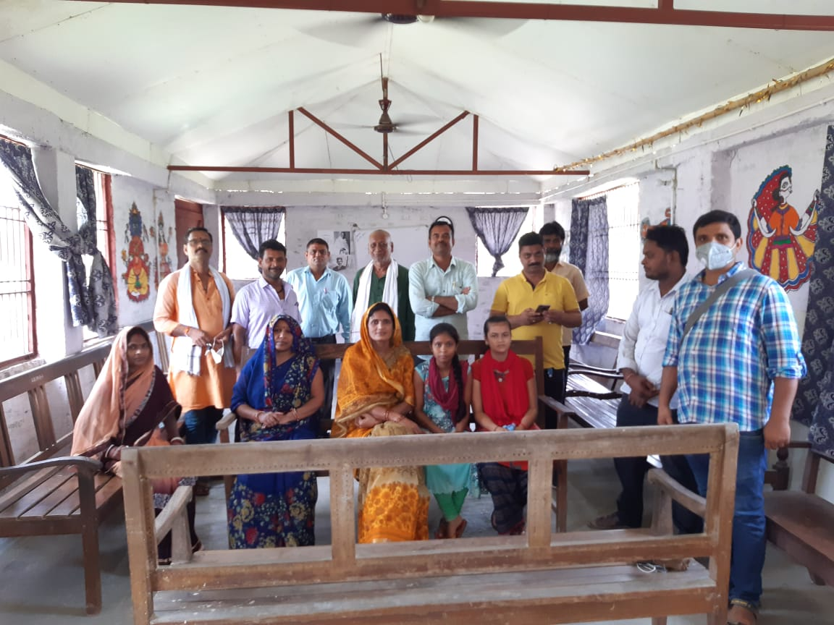
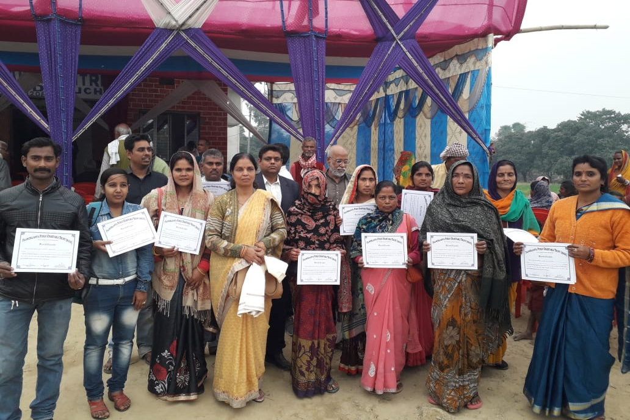
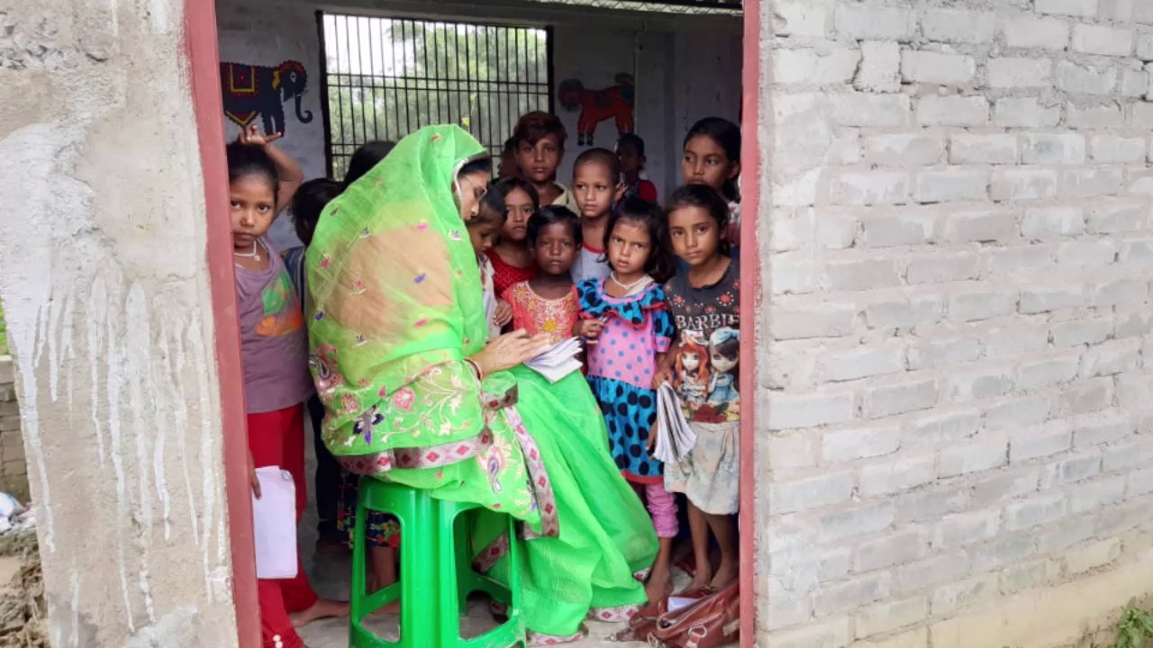
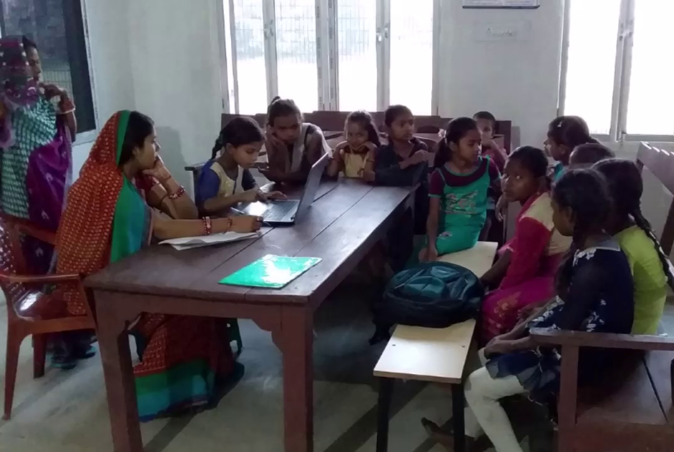
A Few Photos

Slide 18
How You Can Help

Slide 19
If You Are An Indian Citizen
If you are a medical practitioner (physician, nurse, paramedic, and so on), you can join our campaign for creating better healthcare systems for rural India.
If you can teach, you can join the campaign for creating vocational or academic (English, Computers, and Mathematics) skills.
If you can contribute to our cause, we welcome donations that can help us continue to do our work. No amount is too small.
We actually prefer to have non-professional teachers join us, so both sides of the connection profit.

Slide 20
If You Are Outside India
If you are a medical practitioner (physician, nurse, paramedic, and so on), you can join our campaign for creating better healthcare systems for rural India.
If you can teach, you can join the campaign for creating vocational or academic (English, Computers, and Mathematics) skills.
If you have an Indian bank account and can contribute to our cause, we welcome donations that can help us continue to do our work. No amount is too small.

Slide 21
If You Are a Company
You can motivate your employees to contribute some of their time to take a few classes for our children remotely, teaching them something useful (standard subjects and computers).
You can join us in our efforts by supporting our medical or educational efforts financially.

Slide 22
Paanchajanya Public Charitable Trust (Regd.)
Trust Registration Details | Registration No.: 48/2012 OF BK.IV 21.2.2012 with District Registrar, Madras Central. PAN: AACTP1013E
Registered Address | NO. 17, Thiruvalluvar Salai, Taramani, Chennai 600-113.
Managing Trustee | Shreesh (Chandra) Chaudhary. Phone No: 7320822725, 9444028434.
Web Site | www.paanchajanya.org
IT Exemptions | U/S 12AA REGN. NO. DIT(E)NO.2 (435) 12-13 DTD 26-11.2012; U/S 80G REGN. NO. DIT(E)NO.2 (435) 12-13 DTD 16-09-.2013
Years of Operation | 2012-2020

